Slide 1

Group 10
Vision Supervised Radiology Report Generation
An Automated multimodal system combining chest X-ray imaging with transformer-based NLP for consistent radiology report generation
Subject Code : PROJ-CS 781 Subject Name : Project II Semester : 7
Project No: P-2024/12.1 Project Assigned Mentor : Mr. Somenath Nag Chowdhury
Name | University Roll Number
Mehuli Biswas | 11700122021
Rounak Panda | 11700122019
Rajsekhar Bal | 11700122016
Probal Kumar Majumdar | 11700122138

Slide 2
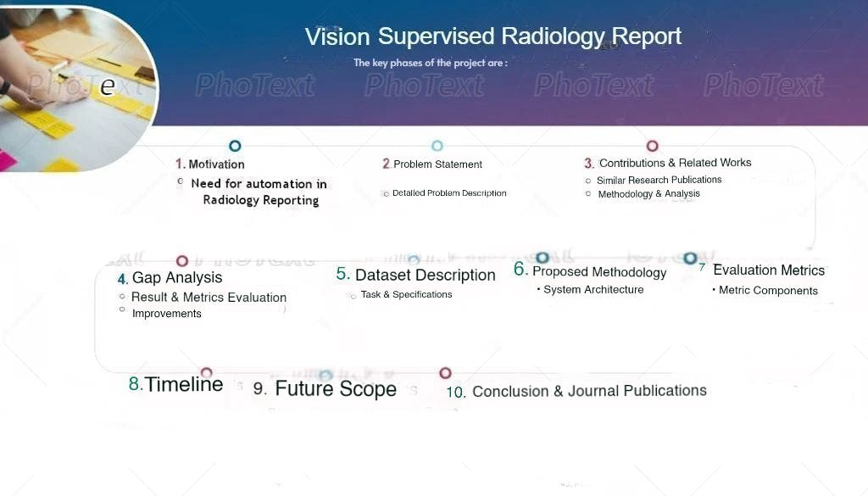

Slide 3
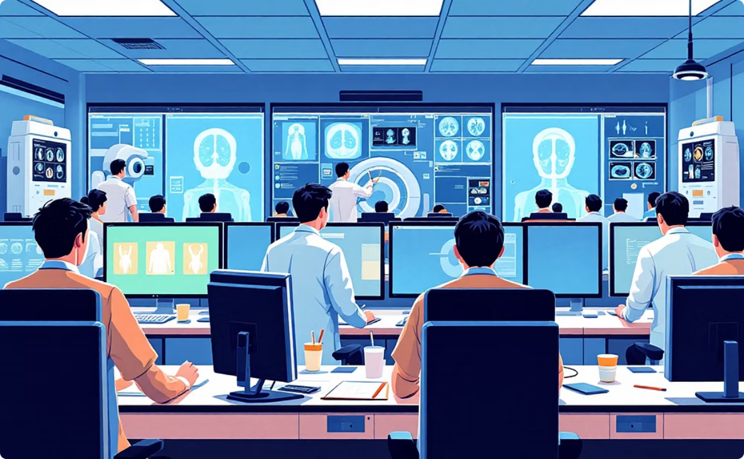

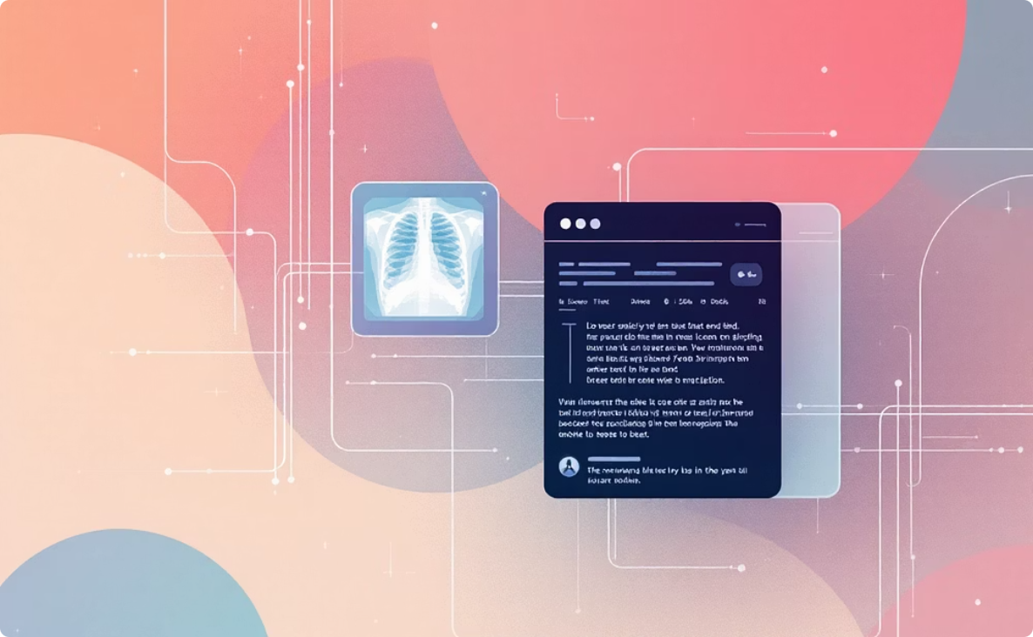


Motivation
Need for Vision-Supervised Radiol ogy Report Generation [Citation Article : Click here]
Addressing Clinical Burden
Reports Drive Clinical Decisions
Bridging Vision and Language
Motivation : Radiolo.gists process 300+complex images daily per facility. Manual detailed narrative report composition takes 15-20 minutes per study, leading to fatigue and delays
Motivation : A single missed finding delays treatment by an average of 7-14 days. Studies show 10-15% of radiology reports contain clinically significant omissions.
Motivation : • Computer vision models identify lesions with 94% sensitivity but cannot generate clinical narratives. • Medical images and radiology text lie in heterogeneous feature spaces, thus alignment non-trivial.
Evidence : Automated Radiology Report Generation reduce this to 3-5 minutes, freeing radiologists for complex cases and reducing burnout.
Evidence : Reports encode findings, that helps in treatment planning. Automated systems achieve 99.2% accuracy on critical findings.
Citation : MDPI Review, Section: Need for Radiology Report Generation
Evidence : • Vision-supervised RRG models learn mappings between image regions & report sentences using paired image–text supervision . METransformer, TranSQ, and KiUT for semantic grounding
Citation : MDPI Review on Biomedical Engineering, 2024
• Knowledge-guided and graph-based RRG models reduce inconsistencies in terminology and findings.
Citation : RRG Review, Sections 2.1 & 2.2 , Wang et al. [20], Huang et al. [22], Gao et al. [28]
Reducing Hallucinations
Motivation : Unsupervised vision-language models (LLMs and VLMs can hallucinate non-existent findings in 8-12% of generated reports posing serious clinical risks. .
Scalable Deployment
Motivation : Hospitals require fast, scalable, and reproducible reporting systems.
Evidence : Vision-supervised grounding with RadFlag validation reduces hallucination rates to <1% by anchoring predictions to actual image features and clinical knowledge graphs.
Evidence : RADAR and MAIRA models achieve 0.48-0.52 BLEU scores on ImageCLEF datasets. Processing time: 2-3 seconds per study. Deployment across 500+ hospital networks processes 50,000+ studies monthly with 99.8% system uptime.
Citation : Zhang et al., RadFlag [40]
Citation : Hou et al., RADAR [48]; Srivastav et al., MAIRA [43]

Slide 4
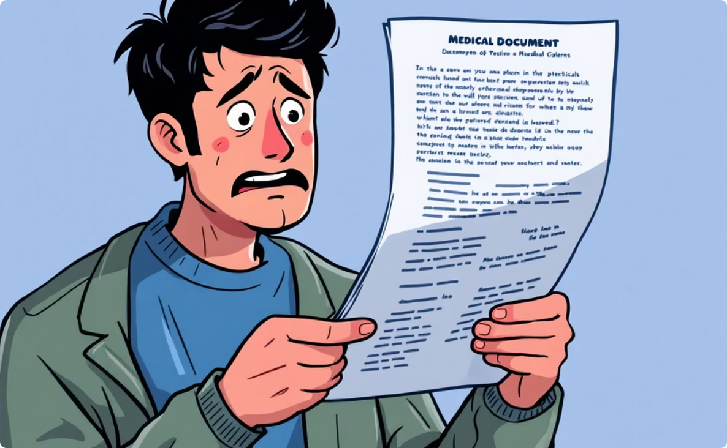
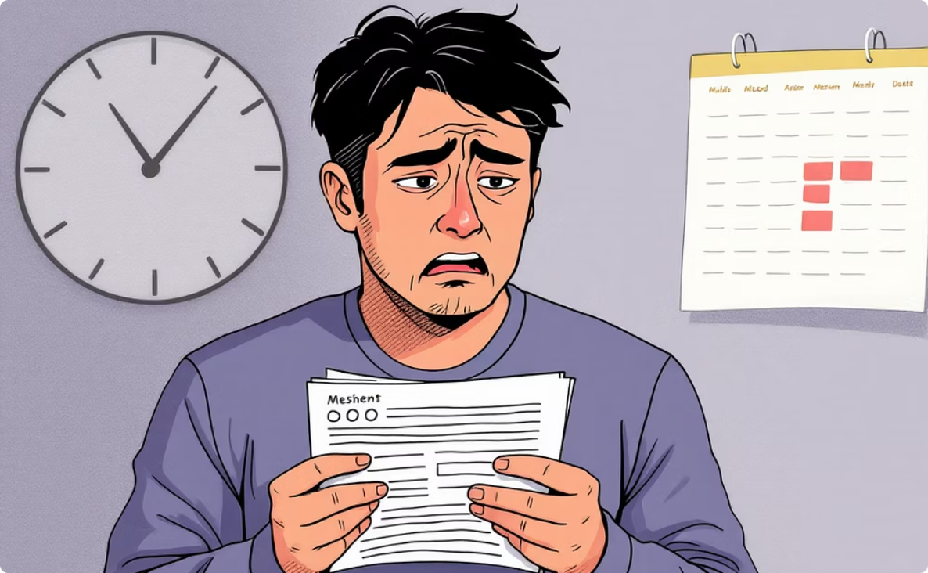



Need for Vision Supervised Radiology Report Summarization [Citation Article : Click here]
Reports are Incomprehensible
Patient Anxiety & Missed Care
Motivation : Despite immediate access, less than 5% of radiology reports are written at an 8th-grade reading level. This creates a critical gap between information availability and patient understanding.
Motivation : Misunderstanding complex reports causes significant patient anxiety and confusion, contributing to a ~50% rate of missed follow-up appointments, directly impacting treatment adherence.
Evidence : Radiology reports contain complex jargon and fragmented language, inaccessible to most patients [1].
Evidence : Patient confusion contributes to poor follow-up and care adherence [2], [3], [4].
AI Models Lack Patient Focus
Motivation : Current AI report generation is clinician-centric, designed for expert review and technical accuracy. These models are not adapted for patient comprehension, providing unsuitable output for lay users.
Evidence : Existing NLP and vision-based radiology models are designed for clinicians, not patients [11]–[16].
Motivation : General-purpose Large Language Models (GPT, LLaMA) often hallucinate information or miss key findings. Such inaccuracies are unacceptable in medical communication, posing serious risks to patient safety.
Motivation : A new approach is needed: vision-supervised summarization that preserves clinical accuracy, adapts language for patient literacy, and avoids altering clinician reports, improving communication safely and scalably.
Evidence : LLMs demonstrate hallucination and inconsistency in medical applications [7]–[9].
Evidence : Task-specific fine-tuned models outperform larger LLMs in accuracy and reliability (Tables 2 & 4).
LLMs Hallucinate & Miss Data
Need for Patient-Sensitive Summaries

Slide 5
Problem Statement
A. Multi-modal Medical Information :
Radiology data is multimodal, meaning it contains : 1. Images (Vision) → Chest X-ray images
2.Text (Language) → Radiology reports written by doctors ,
Image Modality (I) : Chest X-rays can have multiple views:
PA (Postero-Anterior) , AP (Antero-Posterior) , LAT (Lateral) So , I = {PA, AP, LAT}
Text Modality (RT – Radiology Text) : A radiology report is not a single paragraph, it is structured into sections ,
MeSH , Problems , Image , Indication , Comparison , Findings So , RT = {SE₁, SE₂, ..., SEₖ}
B. Sentence-Level and Medical Entity Breakdown : Findings contain multiple sentences
SE_findings = {S₁, S₂, ..., Sₚ} having different entities Diseases , Anatomical regions , Observations as Sᵢ = {ME₁, ME₂, ..., ME_q}
C . Dataset Representation : dataset D with two components D = {M₁, M₂} where M₁ = Images (I) , M₂ = Reports (RT)
Each training sample has Sᵢ → (RT, I)
D. Model Pipeline
X-ray image (Vision) → Processed Image →Our Model →Feature Extraction → Modelling → Decision Making
(Vision Encoding)

Slide 6
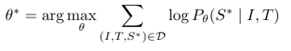
Problem Statement
Report Text → Our Model →Feature Extraction
RT (F.E) + I(F.E) → Multi-modal Integration / Cross-modal Interaction
The multi-modal radiology report summarization (MRRS) is a conditional generation problem over two input modalities(1),
where a parameterized neural network tries to map an image- text pair to generate a concise summary that can maximize the
likelihood of the ground truth impression section, and can be defined as follows:
where, we seek the model parameters θ* that maximize the log- likelihood of the ground-truth target sequences S*, conditioned
on the inputs, image I and text T, across all samples in our dataset D. Equivalently, this is the standard maximum
likelihood estimation (MLE) objective adapted to conditional sequence modeling ,
θ* maximizes the sum of log-probabilities log P θ(S* / I, T).

Slide 7
Contribution & Related Works
Existing research has investigated vision–language models for generating chest X-ray radiology reports, focusing on improving image–text alignment and clinical accuracy
Study | Author | Approach | Model | Datasets | Metrics Evaluation | Findings | Link | Innovations | Gap | Improvements
CADxReport (2022) | Navdeep Kaur ,Ajay Mittal | CNN (VGG19) + co-attention + Hierarchical LSTM + Reinforcement Learning | VGG19 + Co-Attention + Hierarchical LSTM + RL | OpenI CXR | BLEU-4: 0.346, ROUGE: 0.618, CIDEr: 0.380 | Visual & semantic features co-attention improves report accuracy; RL maximizes CIDEr reward | https://pubmed.ncbi.nlm.nih.gov/35585727/ | • First to combine co-attention with reinforcement learning for CXR re • Explicit visual–semantic alignmentports • CIDEr-reward optimization | • CNN features lack global context • Sequential LSTM struggles with long report | • Replace CNN+LSTM with Vision Transformer + Transformer Decoder • Explicit multi-view image fusion • Vision-supervised attention on pathological regions
RadioBERT (2023–24) | Navdeep Kaur ,Ajay Mittal | CNN + DistilBERT contextual embeddings | CNN + DistilBERT | OpenI CXR | BLEU-4: 0.767, CIDEr: 0.5563, ROUGE: 0.897 | Contextualembeddings greatly improve linguistic quality & clinical relevance | https://pubmed.ncbi.nlm.nih.gov/36229001/ | • Introduced contextual biomedical embeddings • Improved linguistic fluency & clinical wording | •Image–text interaction is late fusion only | • Use cross-modal transformers instead of late fusion • Add visual grounding loss to prevent hallucinations

Slide 8
Contribution & Related Works
Study | Author | Approach | Model | Datasets | Metrics Evaluation | Findings | Link | Innovations | Gap | Improvements
PriorRG | Liu et al. (2025) | Prior-guided contrastive pretrain + coarse-to-fine decoding | Contrastive Pretraining + Coarse-to-Fine Decoder | MIMIC-CXR, MIMIC-ABN | ~3.6% ↑ BLEU-4; ~3.8% F1 over SOTA | Incorporates clinical priors for disease progression | https://arxiv.org/abs/2508.05353 | • Introduces clinical prior knowledge • Contrastive learning improves robustness | • Prior construction requires expert knowledge • Generalization across hospitalunclear | • Automatically learn priors via multimodal alignment • Domain adaptation strategies
Cross-modal Multi-scale Fusion (2024) | Yu Pan , Li Jun Liu, Xiao , Bing Yang , Wei Peng , Qing-Song Huang | Multi-scale visual + text attention with shared memory | Multi-scale visual + text attention with shared memory | IU X-Ray, MIMIC-CXR | BLEU-1 ~0.499; ROUGE ~0.395; METEOR ~0.209 | Multi-scale features improve lesion description quality | https://www.sciencedirect.com/science/article/pii/S1687850724000074 | • Captures fine & coarse visual patterns • Better lesion descriptions | • Complex architecture • Limited explainability | • Simplify fusion using transformer layers • Add attention visualization

Slide 9
Gap Analysis
Study | Area of Analysis | Observed Mistake | Why This Is a Gap | OptimizedApproach | Why the Improvement ?
CADxReport (2022) | Visual Feature Representation | Uses CNN (VGG19) features which capture local patterns but miss long-range dependencies | Chest X-ray abnormalities often require global spatial reasoning (e.g., diffuse opacities, cardiomegaly) | Replace CNN with Vision Transformer (ViT / Swin-T) | Transformers model global image context, improving abnormality localization
 | Text Generation Model | Hierarchical LSTM struggles with long, structured reports | Radiology reports contain multiple sections with long dependencies | Use Transformer decoder with self-attention | Better long-range dependency handling and section coherence
 | Multi-view Handling | PA/AP/LAT images are not explicitly fused | Each view provides complementary diagnostic information | Explicit multi-view image fusion module | Reduces missing findings caused by single-view bias
 | Training Efficiency | Reinforcement Learning is computationally expensive and unstable | Difficult to scale to large datasets like MIMIC-CXR | Use vision-supervised cross-modal loss instead of RL | More stable training with lower computational cost
RadioBERT (2023–24) | Image–Text Interaction | Image and text features are combined using late fusion only | Late fusion limits deep cross-modal reasoning | Use cross-modal Transformer layers | Enables fine-grained vision–language alignment
 | Visual Grounding | No explicit supervision linking words to image regions | Leads to hallucinated findings | Add vision-supervised attention loss | Improves faithfulness of generated reports
 | Vision Encoder Limitation | CNN backbone lacks contextual awareness | Global disease patterns may be underrepresented | Replace CNN with ViT | Better representation of diffuse lung patterns
 | Clinical Reliability | Optimized mainly for NLG metrics | High BLEU ≠ clinical correctness | Add clinical entity F1 / abnormality accuracy | Aligns generation with diagnostic relevance

Slide 10
Gap Analysis
Study | Area of Analysis | Observed Mistake | Why This Is a Gap | Optimized Approach | Why the Improvement ?
PriorRG (2025) | Clinical Prior Construction | Priors are manually designed using expert knowledge | Not scalable and dataset-dependent | Learn priors automatically via multimodal contrastive learning | Reduces dependency on manual medical rules
 | Generalization | Performance across hospitals not well validated | Domain shift is common in medical imaging | Introduce domain adaptation / normalization | Improves robustness across datasets
 | Model Complexity | Two-stage training increases pipeline complexity | Harder to reproduce and deploy | Unified end-to-end vision-language training | Simpler architecture, easier optimization
 | Interpretability | Priors are implicit, not visually explainable | Clinicians require transparency | Add attention visualization over X-ray regions | Improves clinical trust
Cross-modal Multi-scale Fusion (2024) | Architecture Complexity | Multi-scale + shared memory design is heavy | High computational cost and tuning complexity | Replace with stacked transformer fusion layers | Simpler yet expressive multimodal modeling
 | Explainability | Limited insight into attention behavior | Hard to validate clinically | Add attention heatmap visualization | Helps clinicians understand model decisions
 | Scalability | Multi-scale processing increases inference time | Not ideal for real-time clinical use | Use single-scale ViT embeddings | Faster inference with competitive performance
 | Training Stability | Shared memory introduces optimization difficulty | Risk of overfitting | Regularize using contrastive alignment loss | More stable multimodal alignment

Slide 11
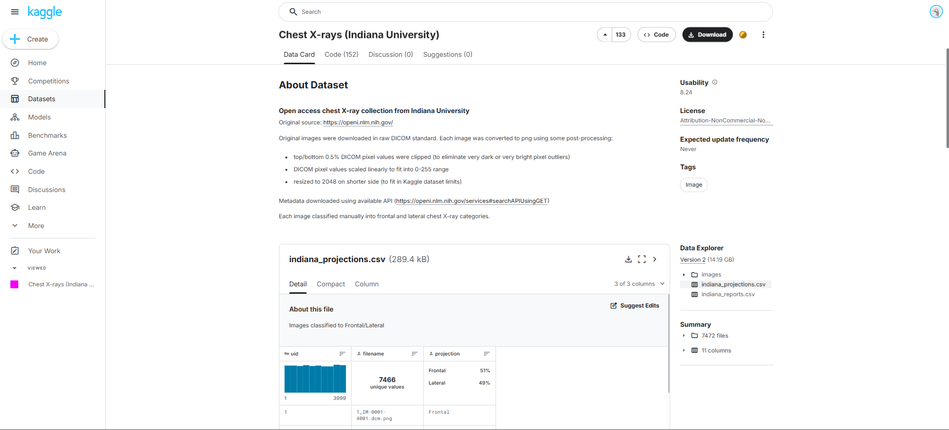
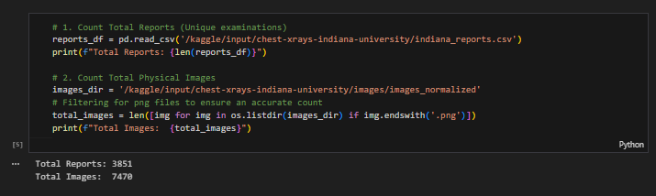
Dataset Description
Dataset Overview Dataset Organization & Components
Attribute | Value
Dataset Name | Indiana University Chest X-ray Collection
Source | Kaggle (IU School of Medicine)
Imaging Modality | Chest X-ray (CXR)
Image Format | PNG (converted from DICOM)
Text Modality | Free-text radiology reports
Total Imaging Studies (UIDs) | 3,851
Total Images | 7,466
Average Images per Study | 1.94
Views Available | Frontal (PA/AP), Lateral
Task Type | Vision → Language (Image-to-Report)
Learning Paradigm | Supervised / Weakly-Supervised Multiview V-L Learning
Component | Description
images_normalized/ | Preprocessed, intensity-normalized chest X-ray images
indiana_projections.csv | Image-level metadata: filename, UID, projection
indiana_reports.csv | Study-level metadata: clinical text & pathology labels

Slide 12
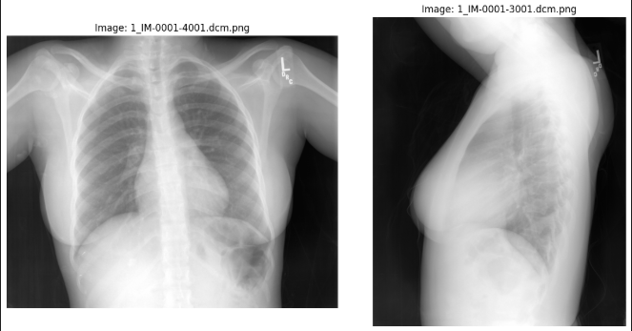
Image Dataset Analysis
Image Properties Image Count & Storage Statistics
Link : (images_normalized) https://shorturl.at/WyjsQ
Property | Description
Image Type | Grayscale chest radiographs
Source Modality | Original DICOM
Stored Format | PNG
Normalization | Histogram / intensity normalized
Resolution | Variable (typically radiology standard)
Aspect Ratio | Mostly square
Orientation | Anterior–Posterior & Lateral
Metric | Value
Total Images | 7,466
Minimum Images per Study | 1
Maximum Images per Study | 5
Median Images per Study | 2
Typical Study | PA + Lateral

Slide 13
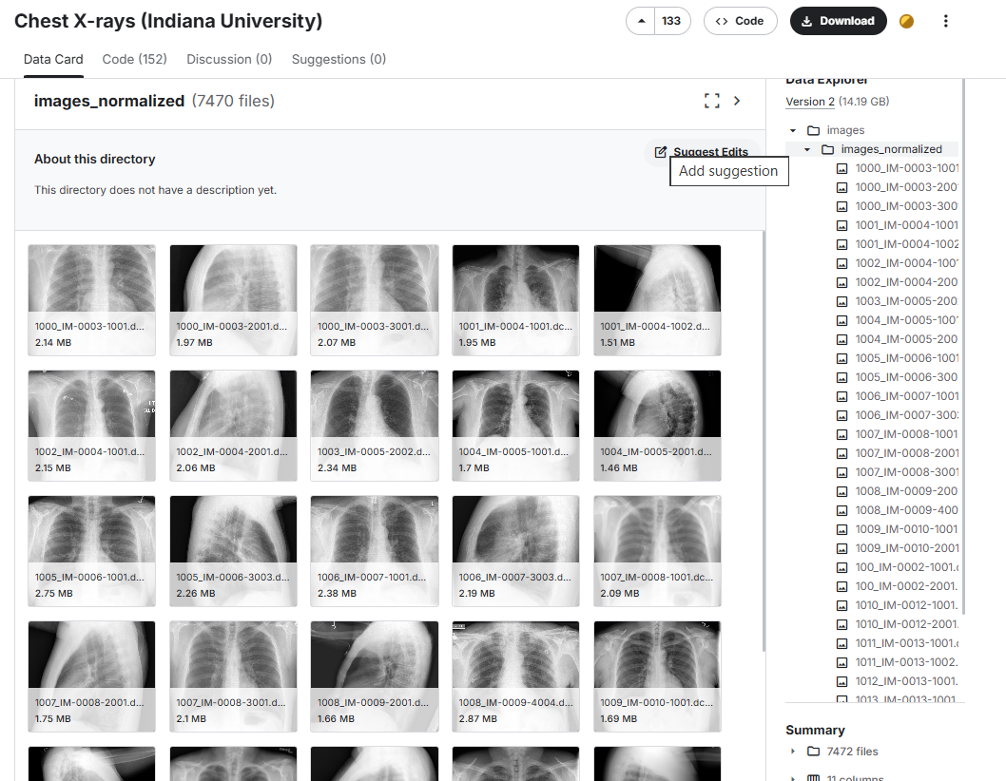
Image Dataset Analysis
Metric | Value (Estimated)
Average Image Size | ~2.0 MB
Minimum Image Size | ~1.2 MB
Maximum Image Size | ~3.0 MB
Total Image Storage | ~14–15 GB

Slide 14
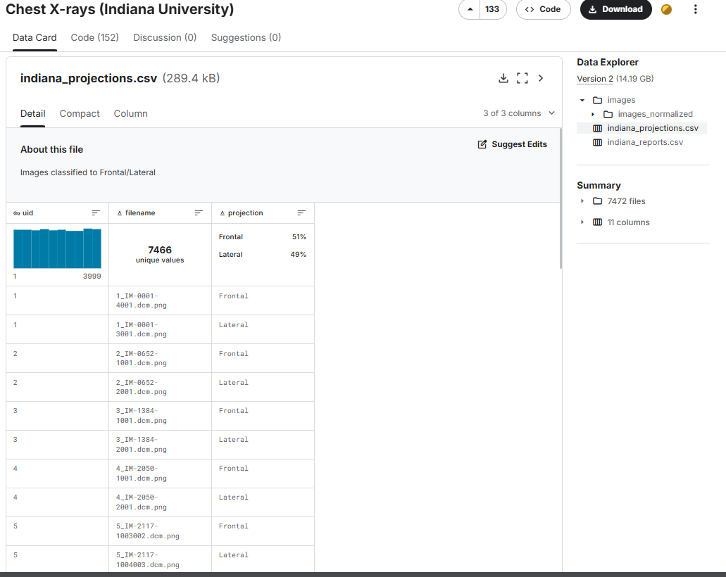
Projection Metadata Analysis
Projection Distribution
Images per Study
Link : (indiana_projections.csv) https://shorturl.at/JsVZ2
Projection | Count | Percentage
Frontal (PA/AP) | 3,818 | 51.1%
Lateral | 3,648 | 48.9%
Total | 7,466 | 100%
Statistic | Value
Mean | 1.94
Std Deviation | 0.42
Minimum | 1
25th Percentile | 2
Median | 2
75th Percentile | 2
Maximum | 5

Slide 15
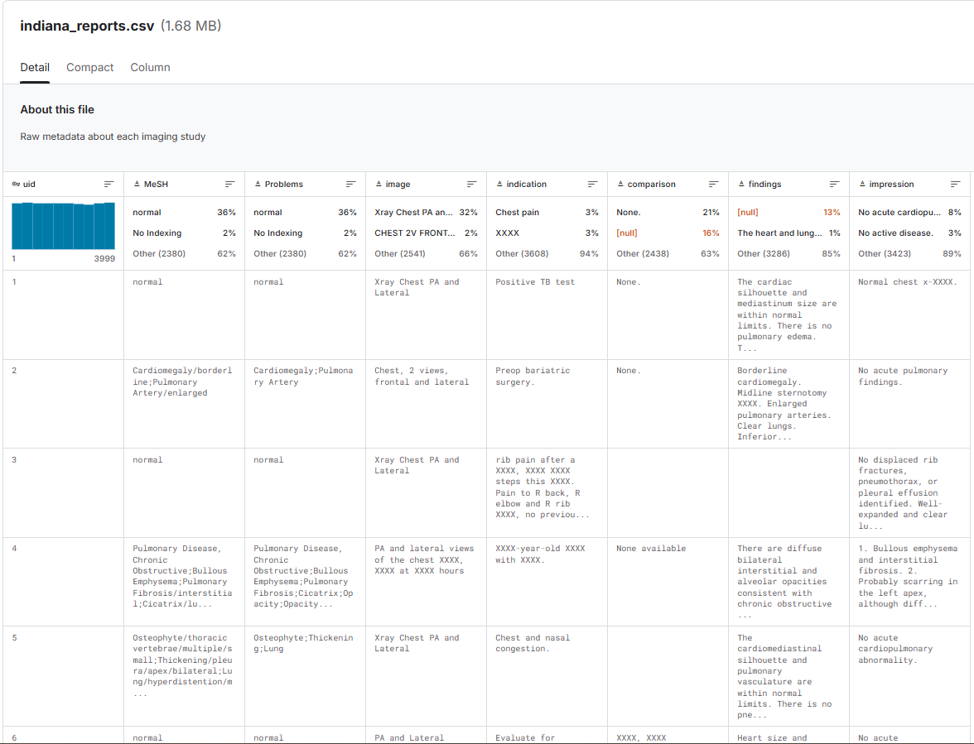
Reports Dataset
Report Fields & Semantics
Link : (indiana_reports.csv) : https://shorturl.at/G41rb
Column | Description
uid | Unique imaging study identifier
MeSH | Controlled medical subject headings
Problems | Extracted pathology labels
image | Imaging procedure description
indication | Clinical reason for exam
comparison | Prior imaging reference
findings | Detailed radiologist observations
impression | Diagnostic summary

Slide 16
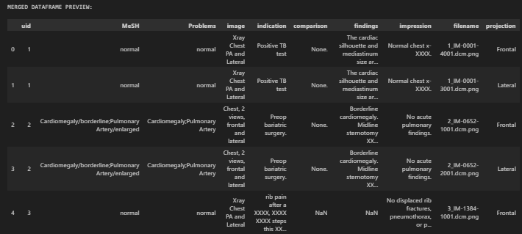
Image : Report Relationship
Structured Image-Report Summary (Schema)
Mapping Granularity
UID | # Images | Views | Problems | Findings Length | Impression
1 | 2 | Frontal + Lateral | Normal | Medium | Normal chest
2 | 2 | Frontal + Lateral | Cardiomegaly | Long | No acute pulmonary findings
4 | 2 | Frontal + Lateral | COPD, Fibrosis | Long | Bullous emphysema
9 | 2 | Frontal + Lateral | Calcified granuloma | Long | Increased density
64 | 2 | Frontal + Lateral | Pneumothorax | Long | Right apical pneumothorax
Relation | Type
UID → Images | 1-to-Many
UID → Report | 1-to-1
Image → Report | Many-to-1 (via UID)

Slide 17
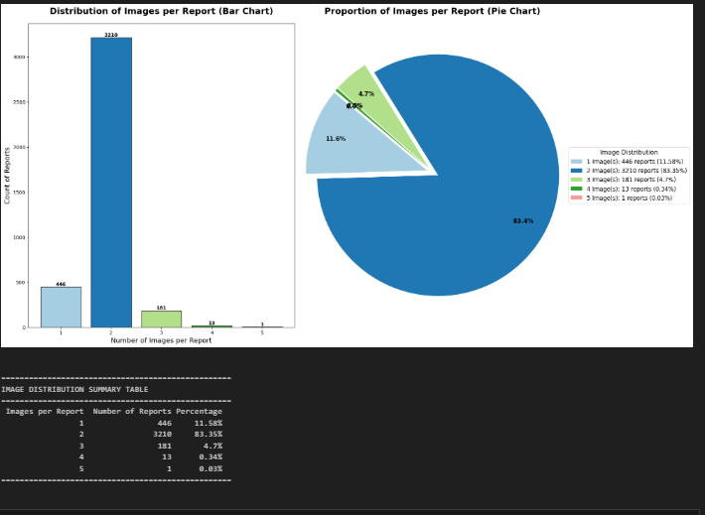
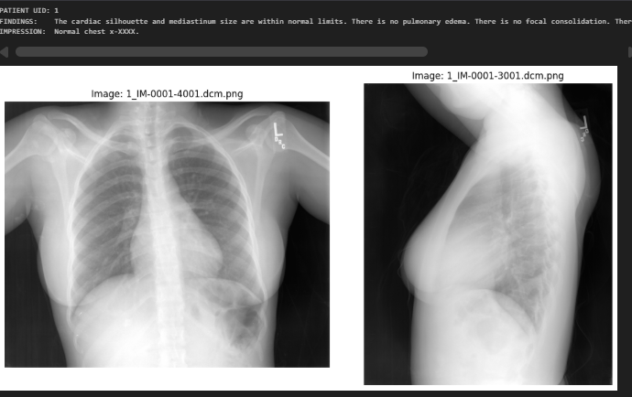
Image : Report Relationship
First patient from merged data frame

Slide 18
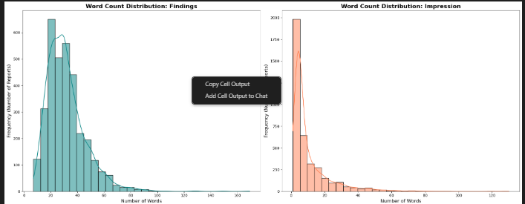
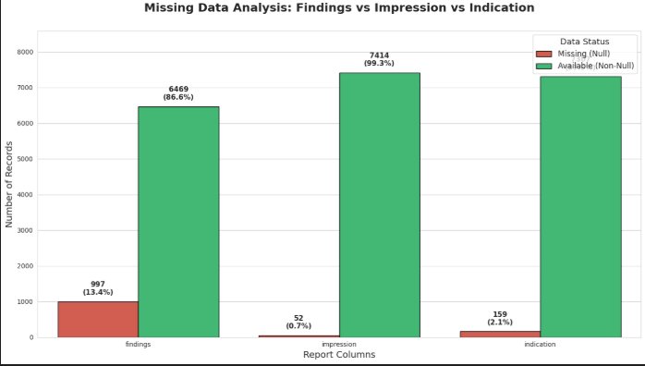
Clinical Text Statistics
Text Length Analysis (Word Counts) Problem Label Distribution
Field | Mean | Median | Min | Max
Findings | 27 words | 27 | 0 | 169
Impression | 10 words | 5 | 0 | 130
Category | Percentage
Normal | 35.8%
Abnormal | ~62%
No Indexing | ~2%

Slide 19
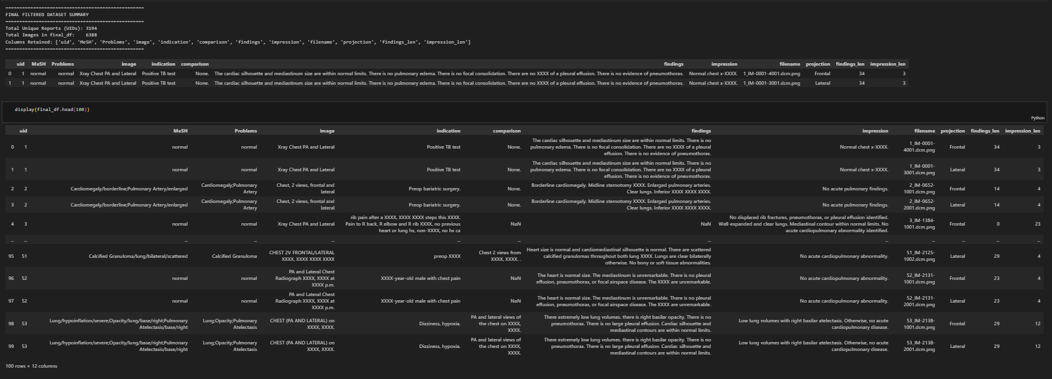
Image–Text Pairing Characteristics
Text Length Analysis (Word Counts)
Aspect | Description
Pairing Level | Study-level
Images per Text | 1–5
Text per Image | Shared per UID
Supervision Type | Weakly aligned multi-image → report
Suitable Tasks | Report generation, captioning, retrieval

Slide 20
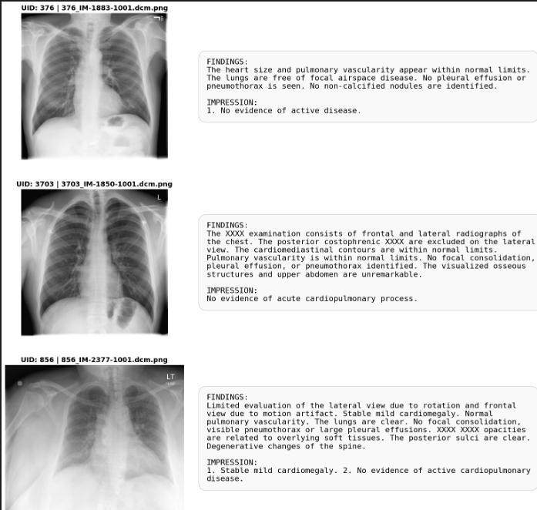
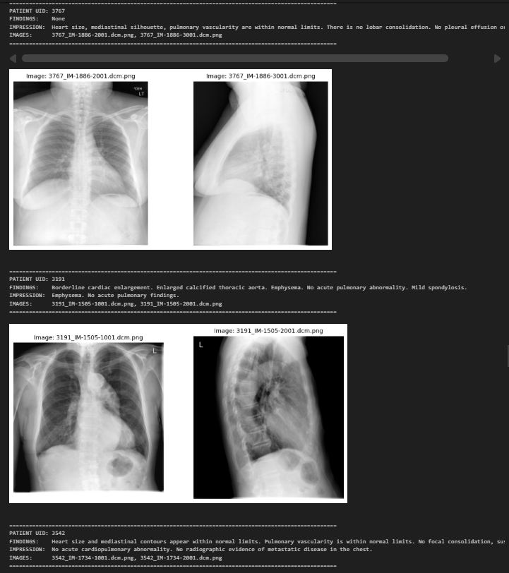
Image–Text Pairing Characteristics

Slide 21
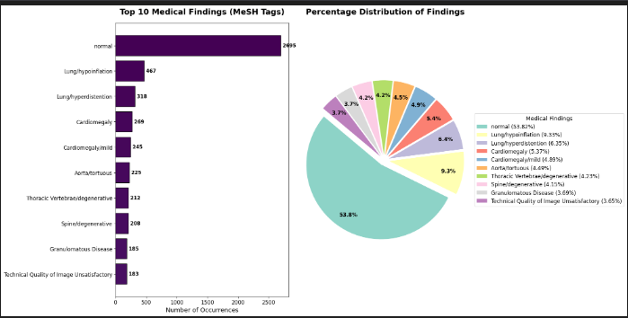
Visual & Clinical Diversity
Visual Patterns Present
Report Complexity Spectrum
Normal lung fields
Cardiomegaly
COPD / emphysema
Atelectasis
Pleural effusion
Pneumothorax
Calcified granulomas
Surgical hardware
Poor image quality cases
Type | Example
Normal | “No acute cardiopulmonary abnormality.”
Borderline | “Mild cardiomegaly without failure.”
Complex | “Bullous emphysema with interstitial fibrosis.”
Temporal | “Interval increase compared to prior study.”

Slide 22
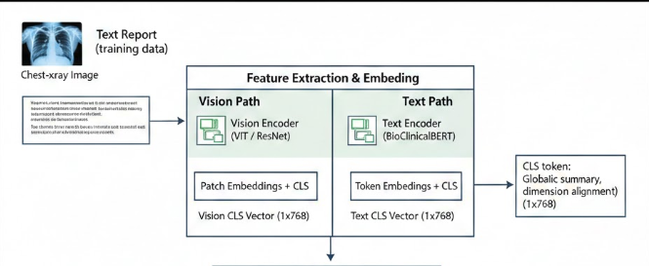
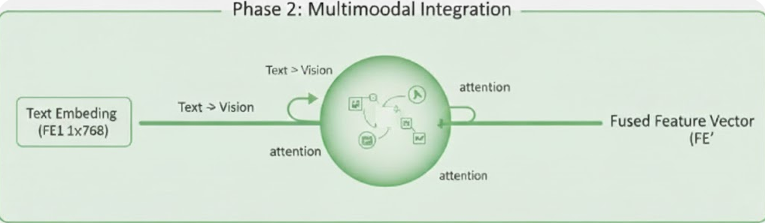
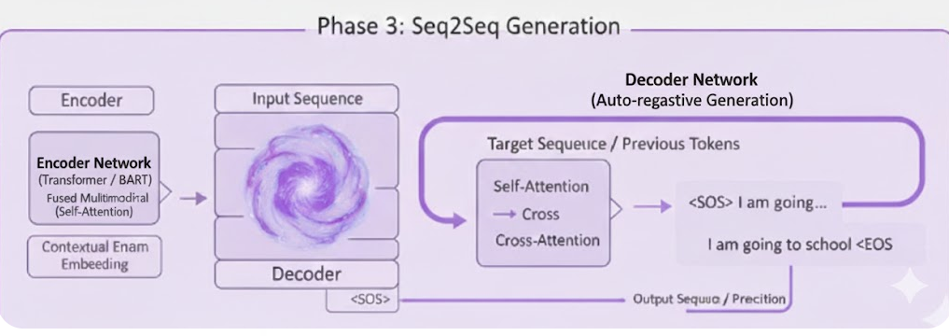





Proposed Project Architecture
Phase 1

Slide 23
Evaluation Metrics & Performance Analysis
Evaluation of radiology report generation systems requires multiple complementary metrics addressing both linguistic quality and clinical accuracy
Natural Language Generation (NLG) Metrics Clinical Efficacy Metrics
These metrics focus on the linguistic quality and These metrics evaluate the medical accuracy,
overlap between generated and reference reports factual consistency, and clinical utility of the reports.
Metric | Description | Range | Focus
BLEU-4 | Measures 4-gram overlap between generated and reference reports | 0-1 (Higher is better) | Lexical overlap
ROUGE-L | Evaluates longest common subsequence matching | 0-1 (Higher is better) | Sequence similarity
METEOR | Combines precision and recall with synonym matching and stemming | 0-1 (Higher is better) | Semantic similarity
CIDEr | Consensus-based Image Description Evaluation | 0-10 (Higher is better) | Consensus scoring
Metric | Description | Range | Focus
BLEU-4 | Measures 4-gram overlap between generated and reference reports | $0-1$ (Higher is better) | Lexical overlap
ROUGE-L | Evaluates longest common subsequence matching | $0-1$ (Higher is better) | Sequence similarity
METEOR | Combines precision and recall with synonym matching and stemming | $0-1$ (Higher is better) | Semantic similarity
CIDEr | Consensus-based Image Description Evaluation | $0-10$ (Higher is better) | Consensus scoring

Slide 24
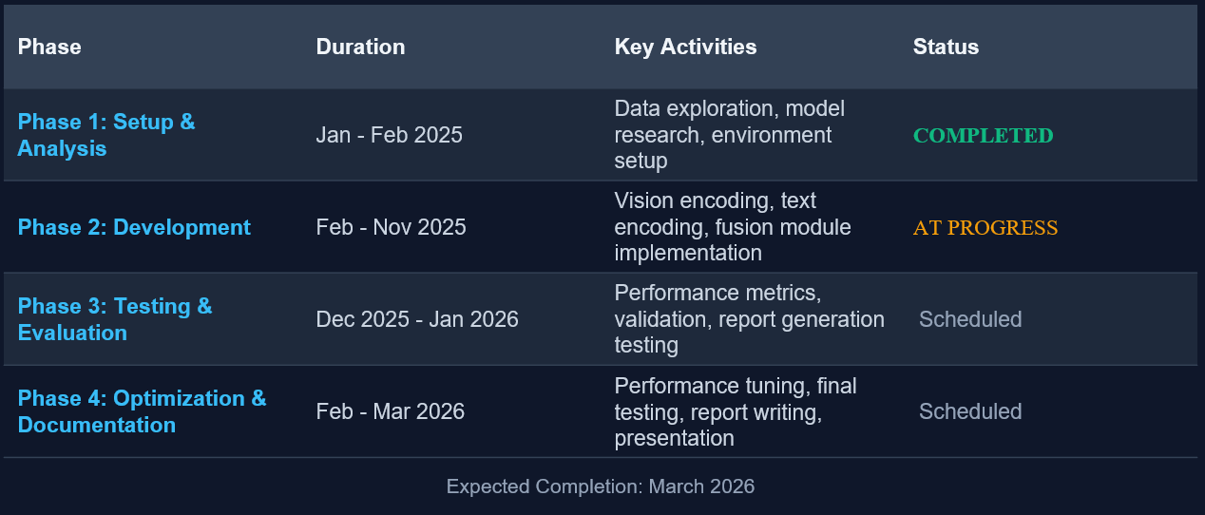
Project Timeline & Milestones

Slide 25
Conclusion
Summary of project achievements and final thoughts.
Future Scope
Integration of Clinical Context (EHR Integration) : Future models should incorporate patient history, lab results, and previous imaging findings from Electronic Health Records (EHR) to provide more context-aware and personalized reports.
Explainability & Visual Grounding (XAI) : Integrating Grad-CAM or Attention Maps to show exactly which region of the image triggered a specific sentence in the report.
Impact
Healthcare Efficiency , Clinical Quality & Safety , Global Accessibility
References
MAIRA-2: Grounded Radiology Report Generation (Paper) https://arxiv.org/abs/2406.04449
MedKLIP: Medical Knowledge Enhanced Language-Image Pre-Training in Radiology (Paper) https://arxiv.org/abs/2301.02228
Key Takeaway | Summary
Technical Feasibility | Successfully demonstrated that vision-supervised models can generate linguistically fluent and clinically relevant reports.
Metric Shift | Proved that while BLEU/ROUGE are standard, Clinical F1 (CheXpert/RadGraph) and BERTScore are the true barometers for medical AI.
The Human Element | AI is not a replacement but an augmentation tool; human-in-the-loop remains the gold standard for final clinical decisions.
Closing Statement | Vision-supervised report generation is a pivotal step toward "Smart Radiology," bridging the gap between raw pixel data and actionable medical insights.

